Slide 1

Self-Introduction
National material service safety science center
2017.9.21
Li Dan

Slide 2

Paper title Correlation between Corrosion Behavior and Microstructure of Precipitated Phases in AZ91 Magnesium Alloy with Rare Earth Addition
Material : AZ91 Magnesium alloy
Rare earth :
yttrium (Y)
misch metal of lanthanum and cerium (La,Ce)
Testing sample:
AZ91 magnesium alloy
AZ91+0.3% Y
AZ91+0.9% Y
AZ91+0.4%(La,Ce)
AZ91+1.0%La,Ce)
Testing methods:
SEM/EDS/TEM microstructure of AZ91 magnesium alloy
LSCM/SPM corrosion behavior of precipitated phases
HRTEM/Peak-Force KPFM combination mechanism and potential difference between matrix and precipitated phases

Slide 3

content
Ⅰ. Microstructure
Ⅱ. Electrochemistry
Ⅲ. Corrosion behavior
ⅰ. macroscopic corrosion morphology(LSCM)
ⅱ . microcosmic corrosion morphology(SPM)
Ⅳ. Correlation between corrosion behavior and microstructure of precipitated phases
ⅰ. Potential difference between matrix and precipitated phases
ⅱ . Interface combination mechanism between matrix and precipitated phases
Ⅴ. Conclusions

Slide 4

Ⅰ. Microstructure
fcc: Al₂Y
tetragonal primitive: Al₂Y₃、Al₁₀Mn₂Y
a)
AZ91
b)
AlMn
a)
AZ91+Y
b)
Matrix:
α-Mg
Results:
AZ91 : α-Mg/β-Mg₁₇Al₁₂/AlMn phases
AZ91+Y: α-Mg/β-Mg₁₇Al₁₂/AlY phases/AlMnY phases
AZ91+(La,Ce): α-Mg/β-Mg₁₇Al₁₂/ Al+(La,Ce) phases/AlMnCe phases
β-Mg₁₇Al₁₂
a)
AZ91+(La,Ce)
b)
Rare earth phases
Rare earth phases
Second phase:
β-Mg₁₇Al₁₂
β-Mg₁₇Al₁₂
bcc: Al₄(La,Ce)
body-centered tetragonal:Al₈Mn₄Ce

Slide 5

Ⅱ. Electrochemistry
Testing method: polarization curve test and hydrogen evolution test
Testing results(corrosion degree):
AZ91> AZ91+(La,Ce) > AZ91+Y

Slide 6

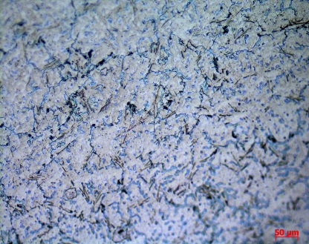
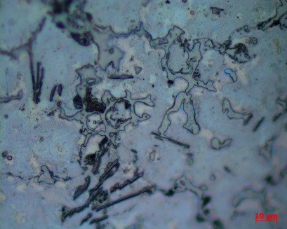
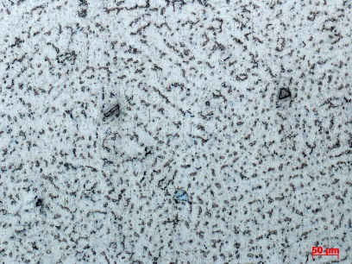
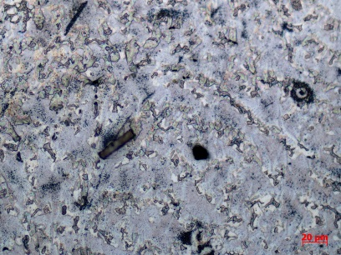
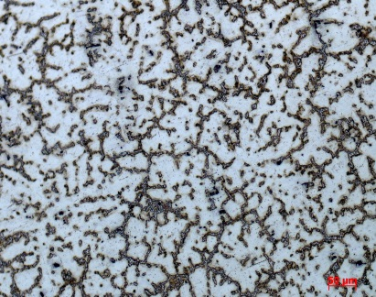
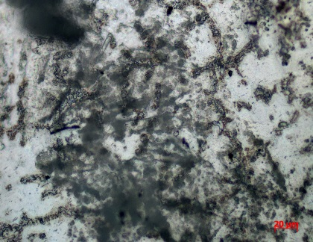
Ⅲ. Corrosion behavior
ⅰ. macroscopic corrosion morphology(LSCM)
Corrosive medium: 3.5%NaCl
Under solution: 60 min
a)
a)
a)
c)
b)
b)
Results:
AZ91 : general corrosion
AZ91+(La,Ce): matrix around rare earth phases
AZ91+Y: matrix around rare earth phases
localized corrosion
AZ91
AZ91+Y
AZ91+(La,Ce)

Slide 7
Ⅲ. Corrosion behavior
ⅱ . microscopic corrosion morphology(SPM)
Corrosive medium: 0.01mol/L NaCl
a)
AZ91+Y
b)
c)
a)
AZ91
b)
c)
a)
AZ91+(La,Ce)
d)
a)
Results:
matrix around rare earth phases was corroded seriously
d)
d)
c)
e)
e)
f)
f)
f)
c)

Slide 8
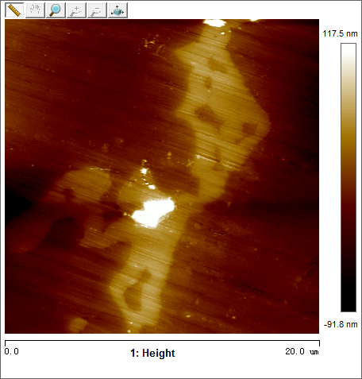
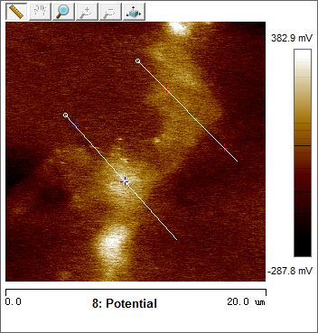

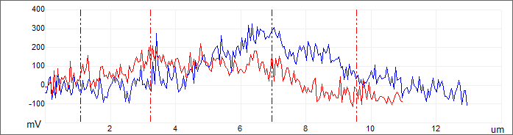
Ⅳ. Correlation between corrosion behavior and microstructure of precipitated phases
ⅰ. Potential difference between matrix and precipitated phases
a)
b)
Testing method: Peak-Force KPFM(SPM)
L1
141mv
L2
338mv
c)
L2
L1

Slide 9
Ⅳ. Correlation between corrosion behavior and microstructure of precipitated phases
ⅰ. Potential difference between matrix and precipitated phases
Results:
α-Mg & β-Mg₁₇Al₁₂ around 150mv
α-Mg & rare earth phases 340mv‾430mv
Higher potential difference, more seriously of corrosion degree
α-Mg & precipitated phases | β | AlMn | Bulk phases | Needle-like phases | Rod-like phases
AZ91 | 141mV | 338mV | ------ | ------ | ------
AZ91+Y | 151mV | ------ | 399mV | ------ | ------
AZ91+ (La，Ce) | 168mV | ------ | 379mV | 430mV | 412mV

Slide 10






Ⅳ. Correlation between corrosion behavior and microstructure of precipitated phases
ⅱ . Interface combination mechanism between matrix and precipitated phases (HRTEM)
a)
b)
c)
FFT
（$1$0$\overline{11}$）
（1$\overline{1}$01）
d)
Inver-FFT
（0$1\overline{1}\overline{2}$）
d=0.2382nm
（$1$0$\overline{11}$）
[01$\overline{1}$1]
（1$\overline{1}$01）
d=0.2415nm

Slide 11
Ⅳ. Correlation between corrosion behavior and microstructure of precipitated phases
ⅱ . Interface combination mechanism between matrix and precipitated phases (HRTEM)
AZ91 |  | AZ91+Y |  | AZ91+(La,Ce)
β | AlMn phases | Al₂Y | Al₁₀Mn₂Y | Al₄(La,Ce) | Al₄(La,Ce) | Al₈Mn₄Ce
semi-coherent | non-coherent | non-coherent |  | semi-coherent interface | non-coherent
Results:
α -Mg & β-Mg₁₇Al₁₂ semi-coherent
α-Mg & rare earth phases non-coherent
Interface energy: non-coherent>semi-coherent
Higher interface energy, more easily to induce corrosion behavior

Slide 12

Ⅴ. Conclusions
ⅰ. Corrosion resistance enhanced after rare earth addition;
ⅱ. Although heavily corrosion occurred around rare earth phases, general corrosion of alloys was reduced.
ⅲ. Matrix around rare earth phases is more easily to corrosion because of higher interface energy and higher potential difference.

Slide 13

Thank you!

